Slide 1



Health Care Data Harmonization Using: Shiny, Clinical Expertise, and RDBMS
Seth Russell, MS
Peter E. DeWitt, Ph.D.
useR!
Aug 2025
Bringing Sight to Life

Slide 2
Disclosures
This work was supported by:
Eunice Kennedy Shriver National Institute of Child Health and Human Development grant R01HD105939 to Drs Sanchez-Pinto and Bennett.
Related Publications:
Development and Validation of the Phoenix Criteria for Pediatric Sepsis and Septic Shock
L. Nelson Sanchez-Pinto*, MD, MBI; Tellen D. Bennett*, MD, MS; Peter E. DeWitt**, PhD; Seth Russell**,MS; Margaret N. Rebull, MA; Blake Martin, MD; Samuel Akech, MBChB, MMED; David J. Albers, PhD;Elizabeth R. Alpern, MD, MSCE; Fran Balamuth, MD, PhD, MSCE; Melania Bembea, MD, MPH, PhD; Mohammod Jobayer Chisti, MBBS, MMed, PhD; Idris Evans, MD, MSc; Christopher M. Horvat, MD, MHA; Juan Camilo Jaramillo-Bustamante, MD; Niranjan Kissoon, MD; Kusum Menon, MD, MSc; Halden F. Scott, MD, MSCS; Scott L. Weiss, MD; Matthew O. Wiens, PharmD, PhD; Jerry J. Zimmerman, MD, PhD; Andrew C. Argent***, MD, MBBCh, MMeg; Lauren R. Sorce***, PhD, RN, CPNP-AC/PC; Luregn J. Schlapbach***, MD, PhD; R. Scott Watson***, MD, MPH; and the Society of Critical Care Medicine Pediatric Sepsis Definition Task Force JAMA. https://doi.org/10.1001/jama.2024.0196 Published online January 21, 2024.
International Consensus Criteria for Pediatric Sepsis and Septic Shock
Schlapbach LJ, Watson RS, Sorce LR, et al. JAMA. 2024;331(8):665–674. https://doi.org/10.1001/jama.2024.0179
https://github.com/magic-lantern/2025-useR

Slide 3
Disclosures
The study was approved with a waiver of consent by a central institutional review board at the University of Colorado, plus separate regulatory approvals at non-US sites.
https://github.com/magic-lantern/2025-useR

Slide 4
Motivation
Sepsis – infection with life-threatening organ dysfunction.
Our work focused on Pediatric Sepsis. Many pediatric survivors of sepsis have ongoing physical, cognitive, emotional, and psychological sequelae, which may have long-term effects on them and their families. Sepsis in children has important differences to adult sepsis, including:
Age-specific variability of vital signs
developmental age-dependent immune function,
Pediatric-specific comorbidities, epidemiology, and outcomes
Sepsis is a leading cause of death among children worldwide. Prior to this work the most current pediatric-specific criteria for sepsis were published in 2005 based on expert opinion. In 2016, the Third International Consensus Definitions for Sepsis and Septic Shock (Sepsis-3) defined sepsis as life-threatening organ dysfunction caused by a dysregulated host response to infection, but it excluded children.
https://github.com/magic-lantern/2025-useR

Slide 5
Study
Aim 1: Determine the optimal clinical criteria for each pediatric organ dysfunction in differently resourced settings and care environments
Aim 2: Develop and validate novel pediatric sepsis criteria
Aim 3: Design, build, and evaluate prototype CDS tools to facilitate use of the new pediatric sepsis criteria
https://github.com/magic-lantern/2025-useR

Slide 6
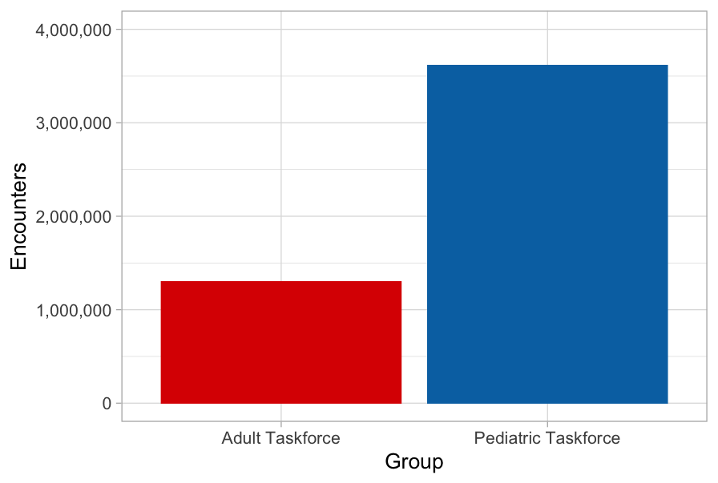
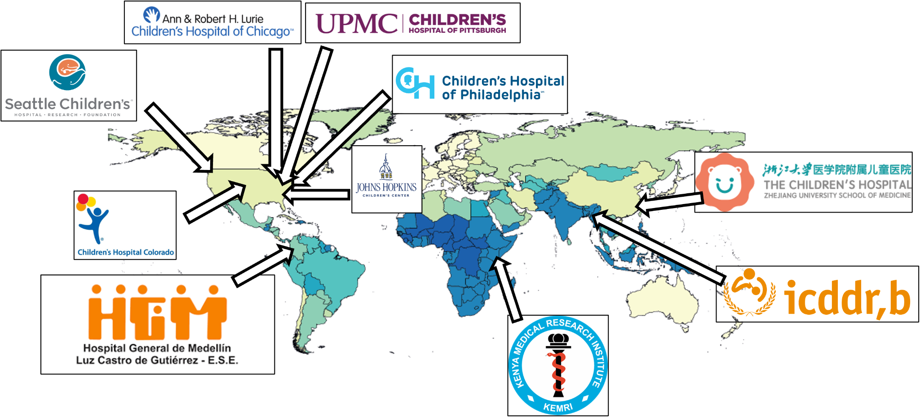
Study
3,613,923
1,309,025
https://github.com/magic-lantern/2025-useR

Slide 7
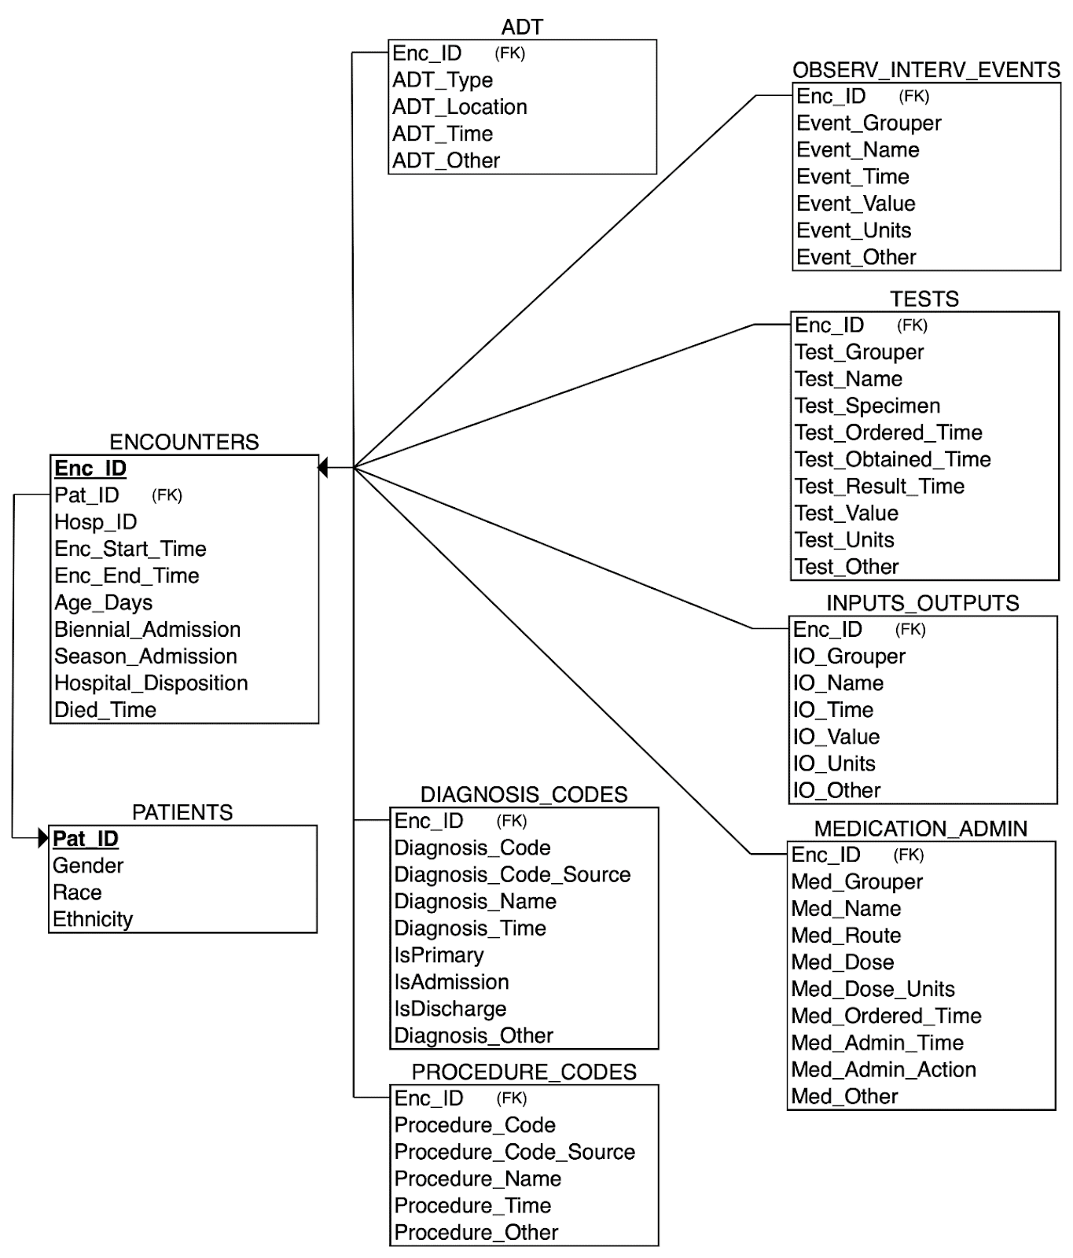
Data Model

Slide 8
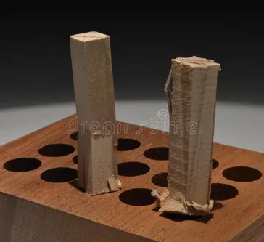

Provided Data
2,276,521,018 rows of data
1,750,278,937 rows of data
https://www.dreamstime.com/square-peg-round-hole-having-been-forced-image245578184
https://www.royalscottishacademy.org/artworks/9375-dylan-esposito-round-peg-in-a-square-hole-2022/

Slide 9








Data Harmonization
?
?
?
?
?
?
?
?
?
?
Map multiple source row types to one harmonized type
Site and source specific unit harmonization
Site and source specific value transformations
Review
Repeat
SQL Database
https://github.com/magic-lantern/2025-useR

Slide 10
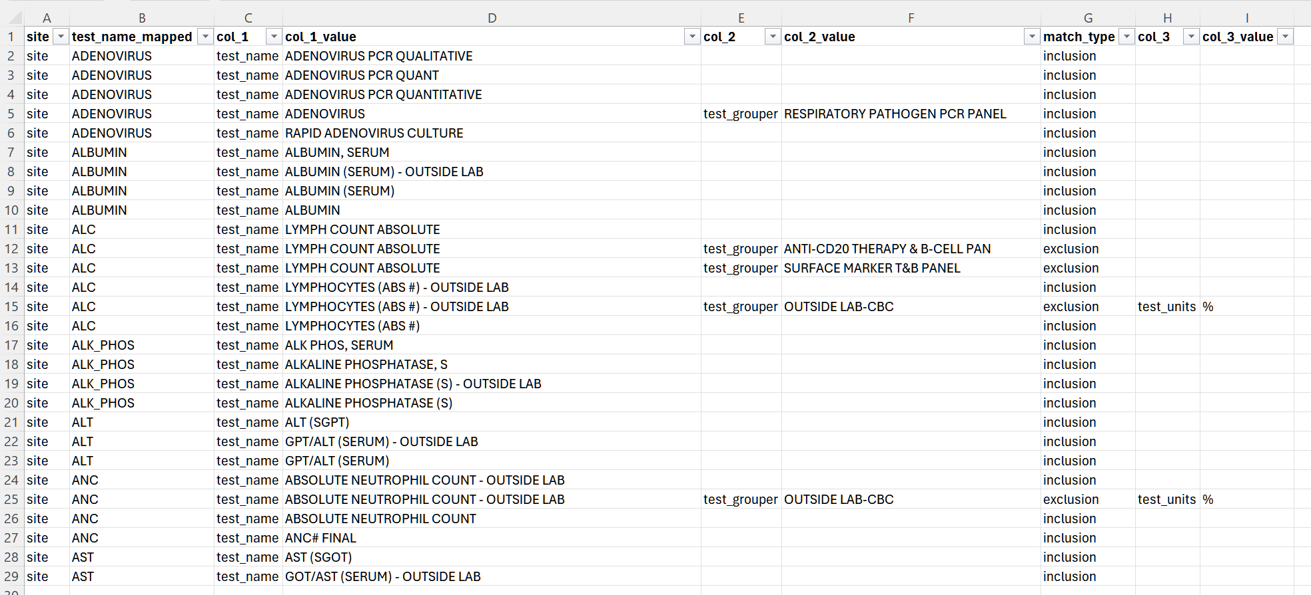
https://github.com/magic-lantern/2025-useR

Slide 11
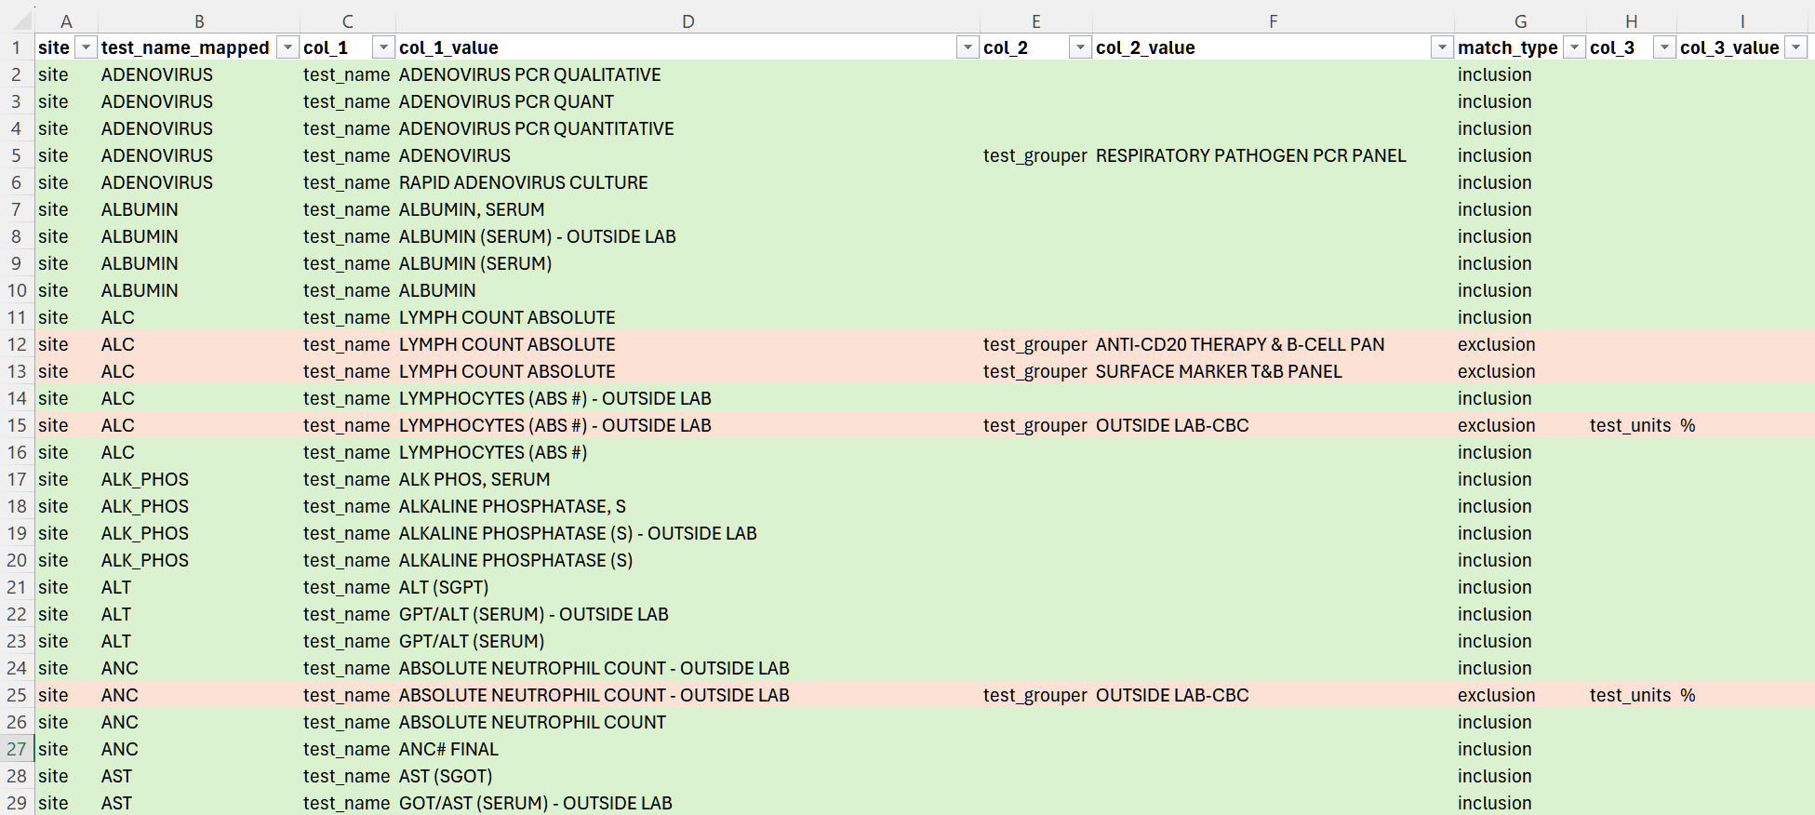
https://github.com/magic-lantern/2025-useR

Slide 12
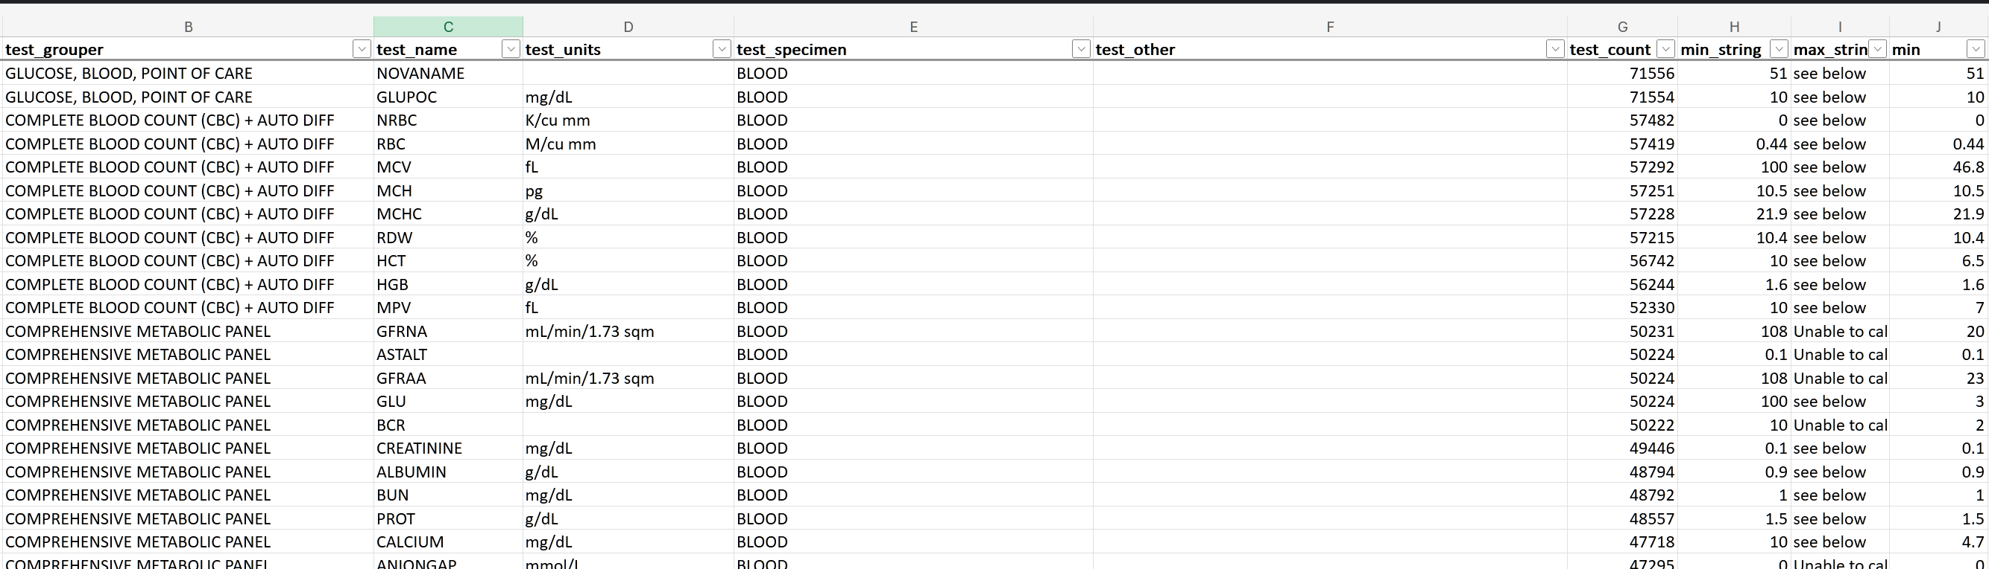
https://github.com/magic-lantern/2025-useR

Slide 13
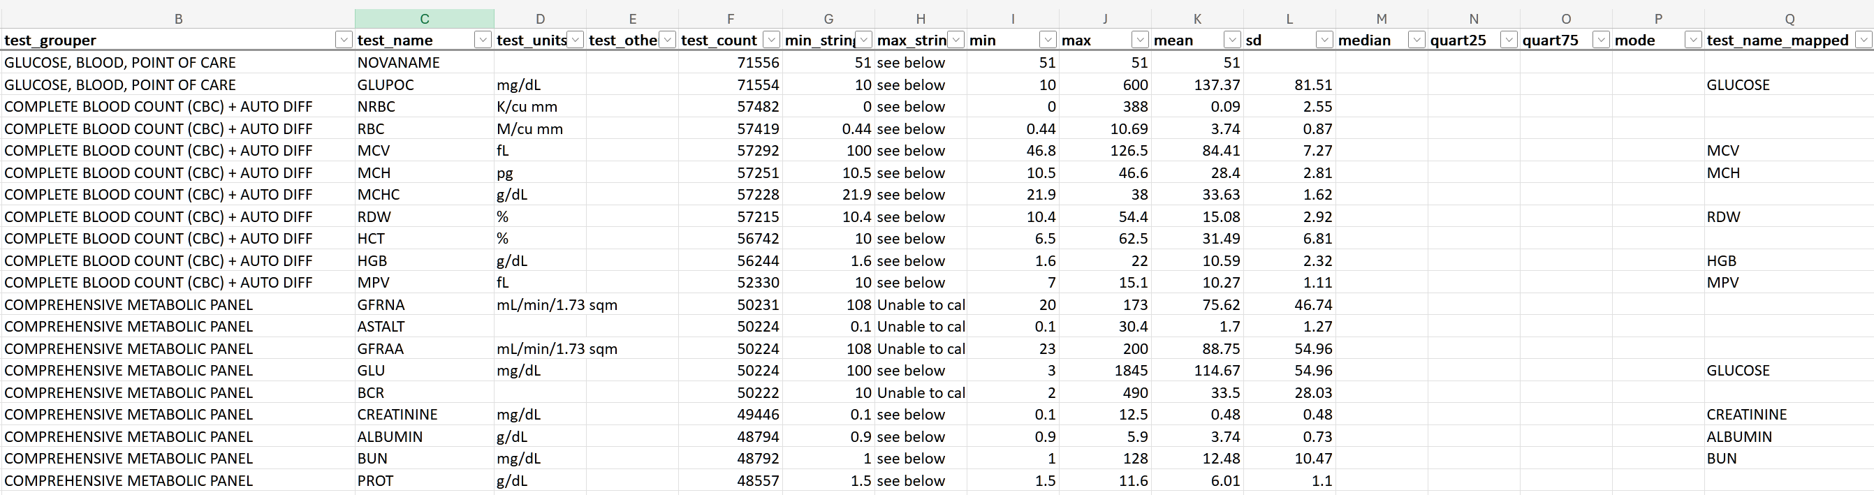
https://github.com/magic-lantern/2025-useR

Slide 14
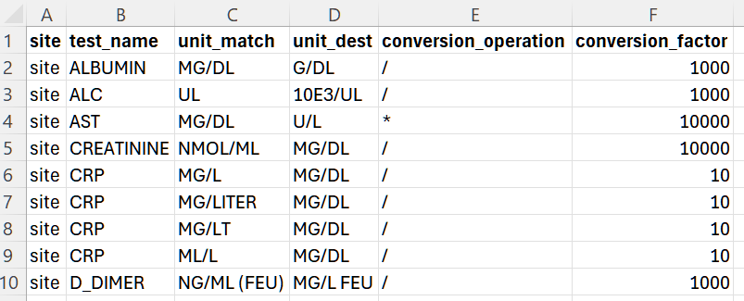
Unit harmonization
https://github.com/magic-lantern/2025-useR

Slide 15
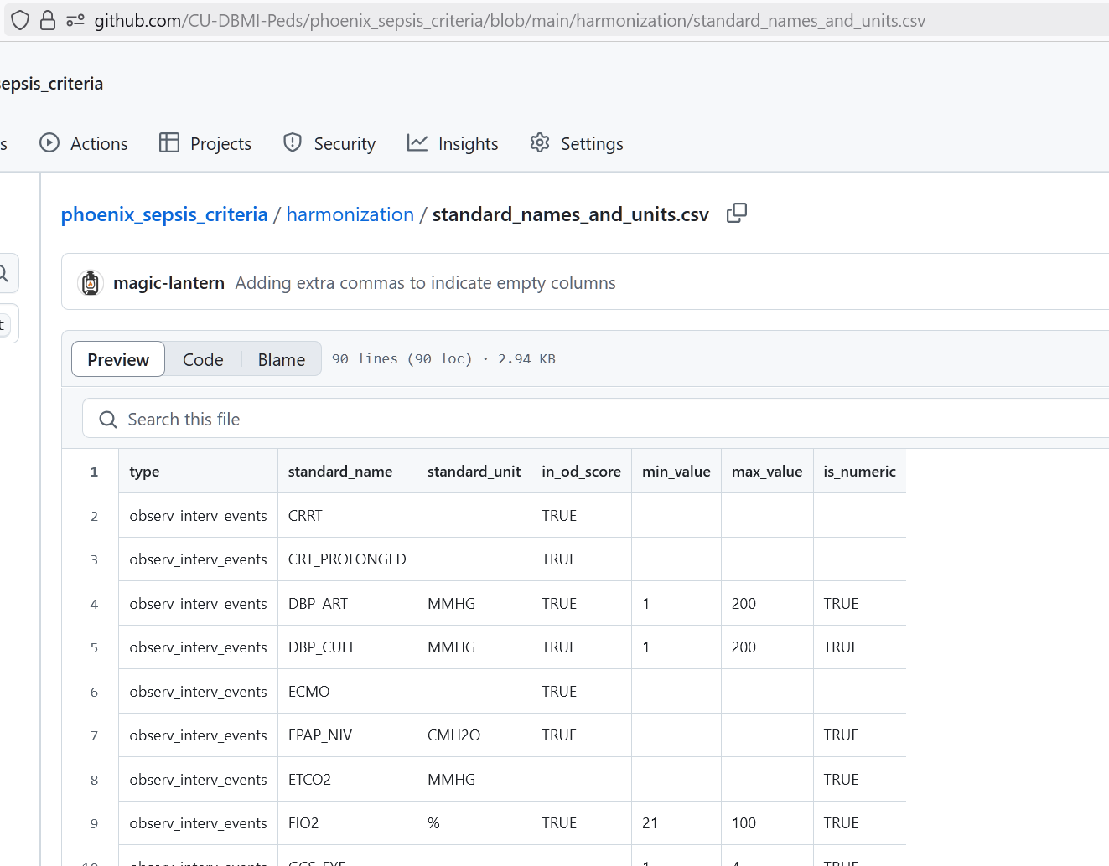
Value Thresholding
https://github.com/CU-DBMI-Peds/phoenix_sepsis_criteria/blob/main/harmonization/standard_names_and_units.csv

Slide 16
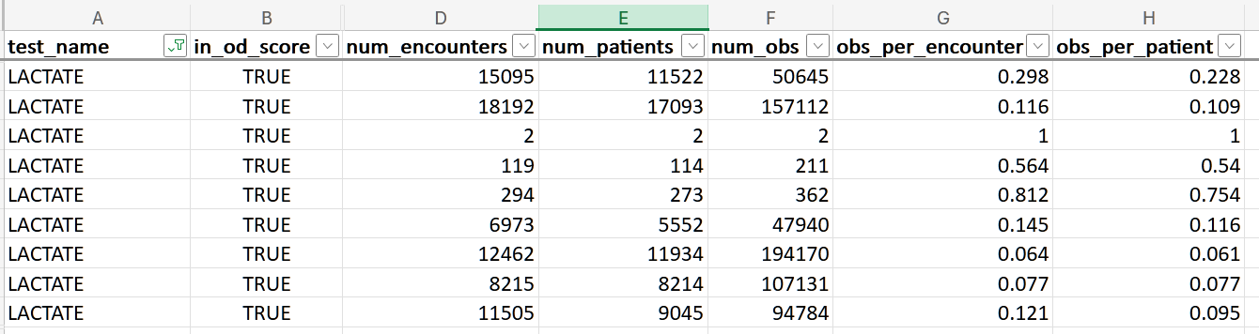
Review
https://github.com/CU-DBMI-Peds/phoenix_sepsis_criteria/tree/main/harmonization
https://github.com/magic-lantern/2025-useR

Slide 17
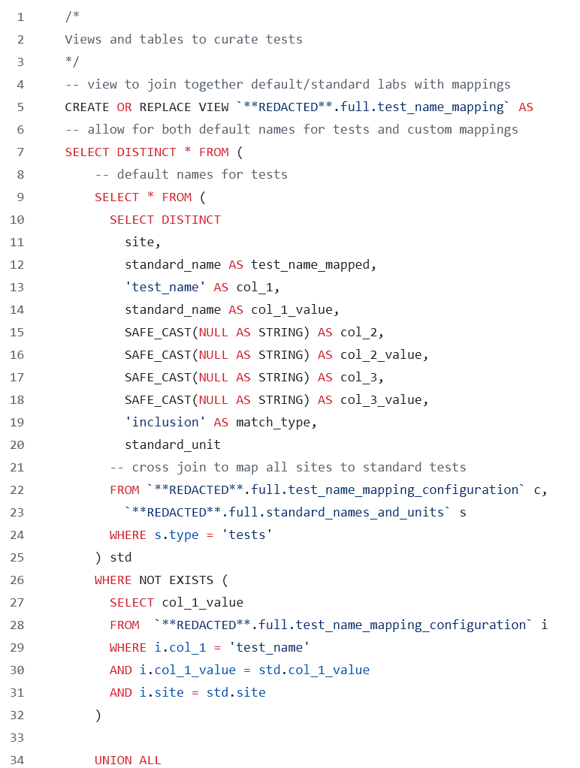
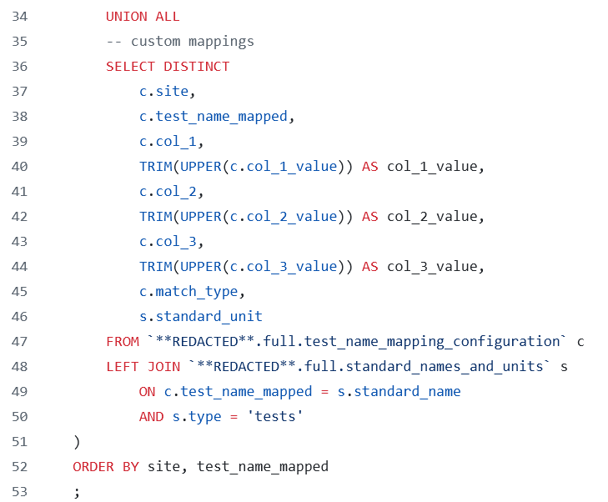
Process on RDBMs
https://github.com/CU-DBMI-Peds/phoenix_sepsis_criteria/blob/main/harmonization/harmonize_tests.sql

Slide 18
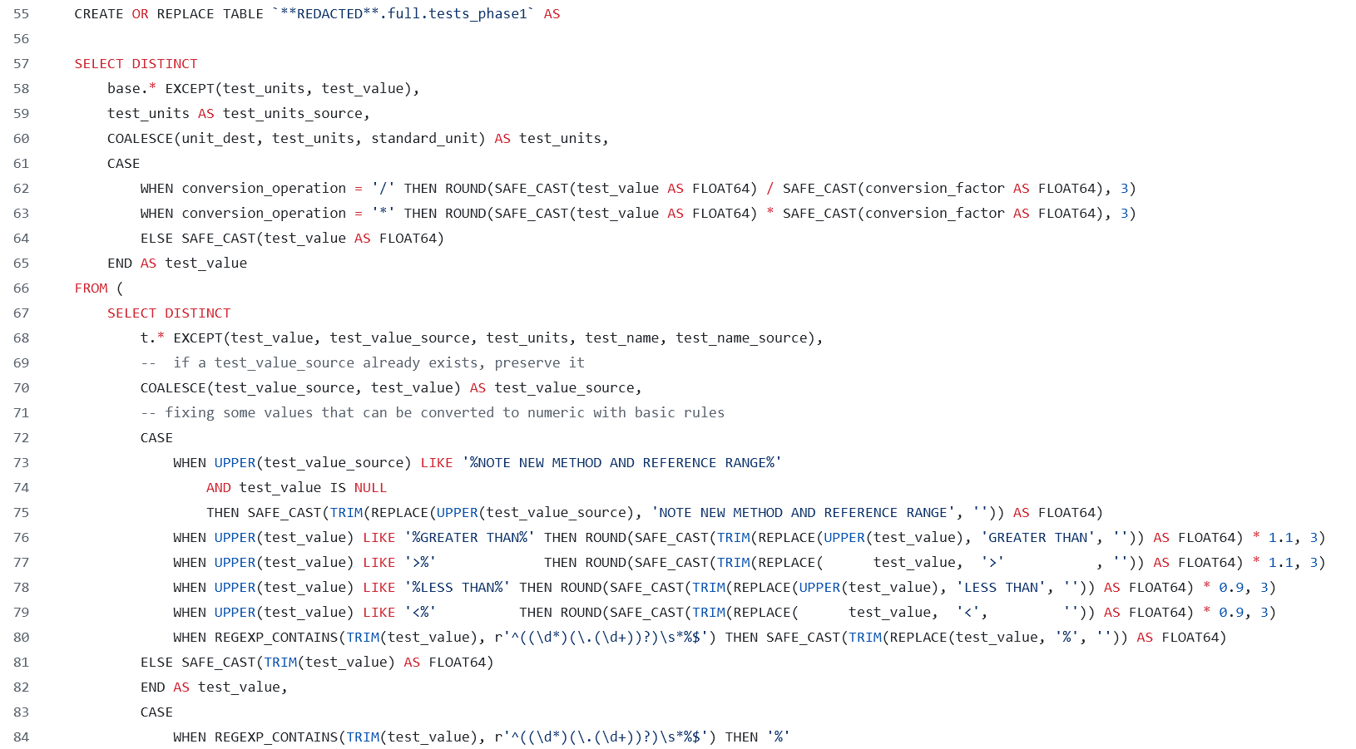
Process on RDBMs
https://github.com/CU-DBMI-Peds/phoenix_sepsis_criteria/blob/main/harmonization/harmonize_tests.sql

Slide 19
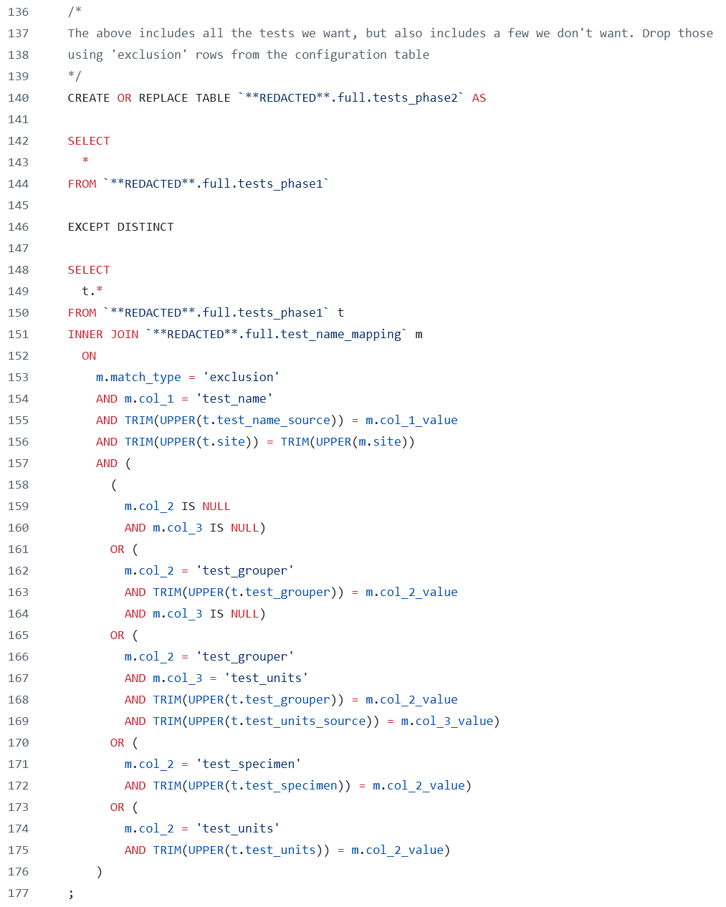
Process on RDBMs
https://github.com/CU-DBMI-Peds/phoenix_sepsis_criteria/blob/main/harmonization/harmonize_tests.sql

Slide 20
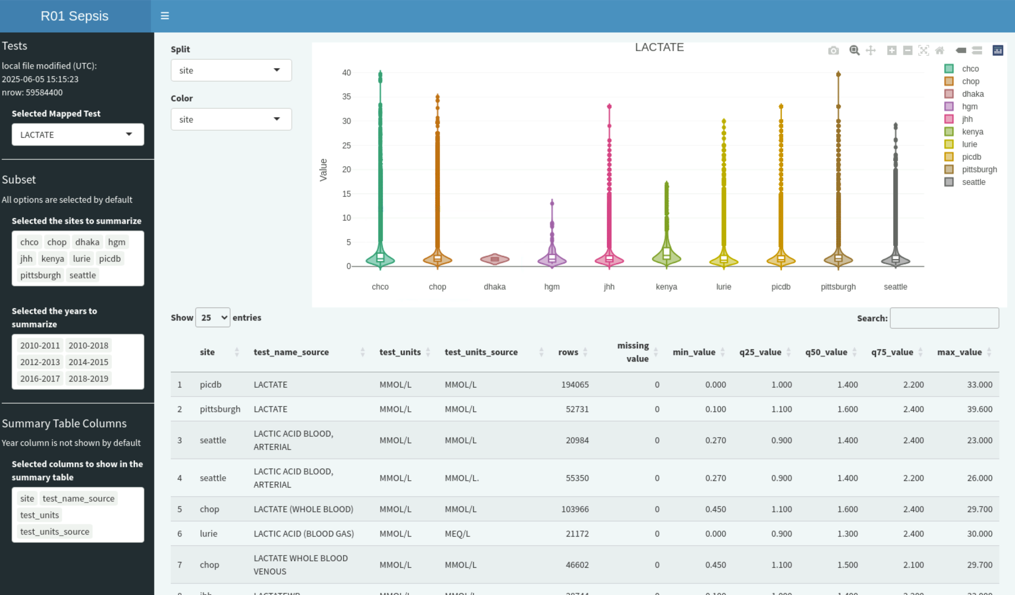

Slide 21
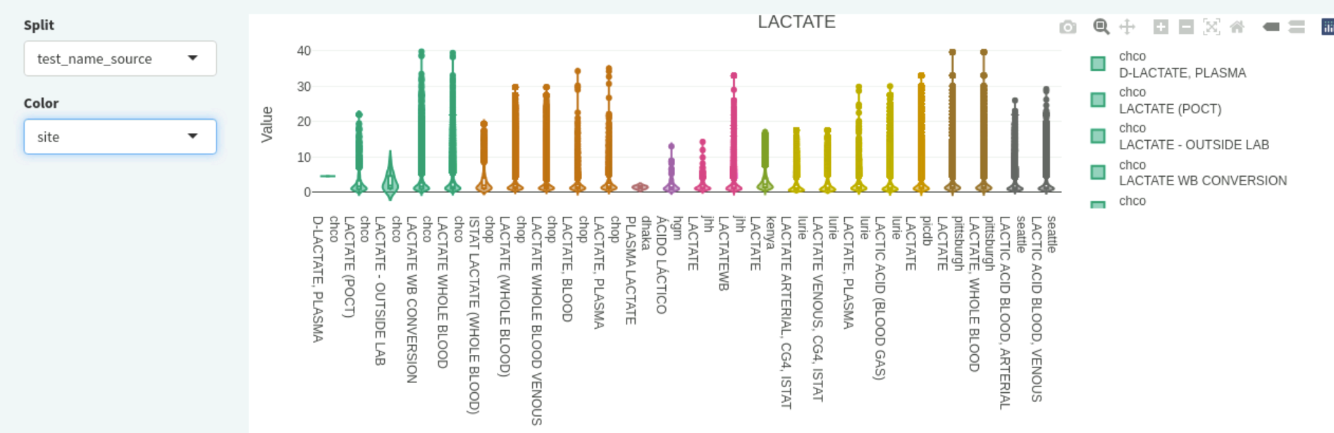
https://github.com/magic-lantern/2025-useR

Slide 22
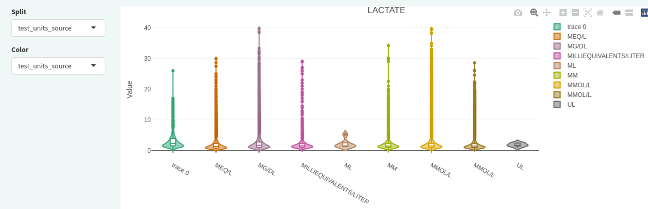
https://github.com/magic-lantern/2025-useR

Slide 23
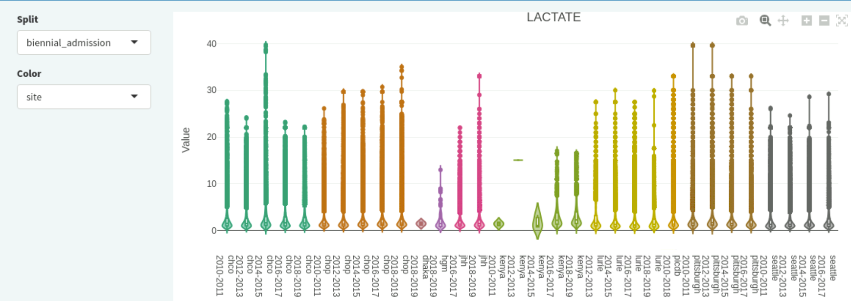
https://github.com/magic-lantern/2025-useR

Slide 24
Harmonization: the Unsung Hero
?
?
?
?
?
?
?
?
$
?
?
Slides available at:
https://github.com/magic-lantern/2025-useR
Please reach out to me with questions!

